Slide 1

Dataset flower

Slide 2

Reference
Chapter 13 (O'Reilly) of Hands-On ML
Youtube on urllib.request.urlretrieve
Youtube
Code

Slide 3
Download flower

Slide 4


Slide 5


Slide 6
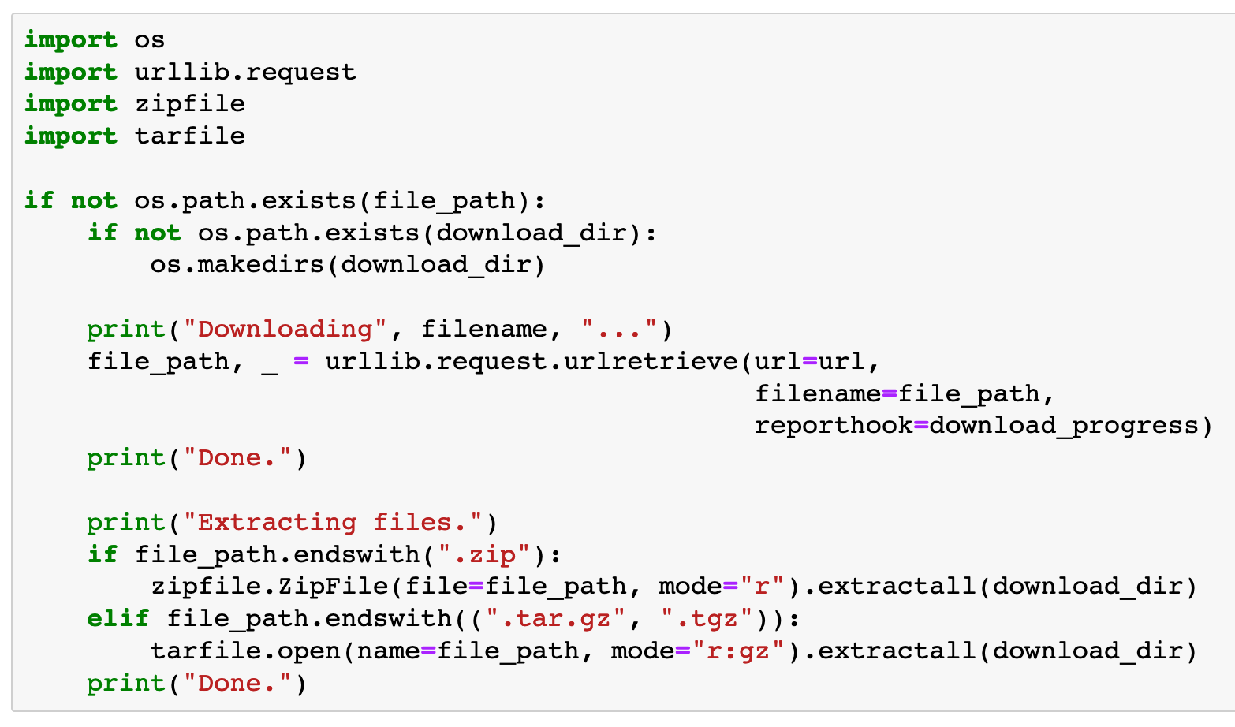

Slide 7


Slide 8
Create flower_classes list

Slide 9



Slide 12
Create image_paths dict

Slide 13


Slide 14
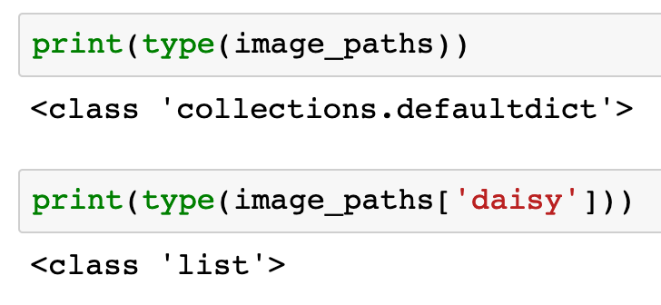

Slide 16
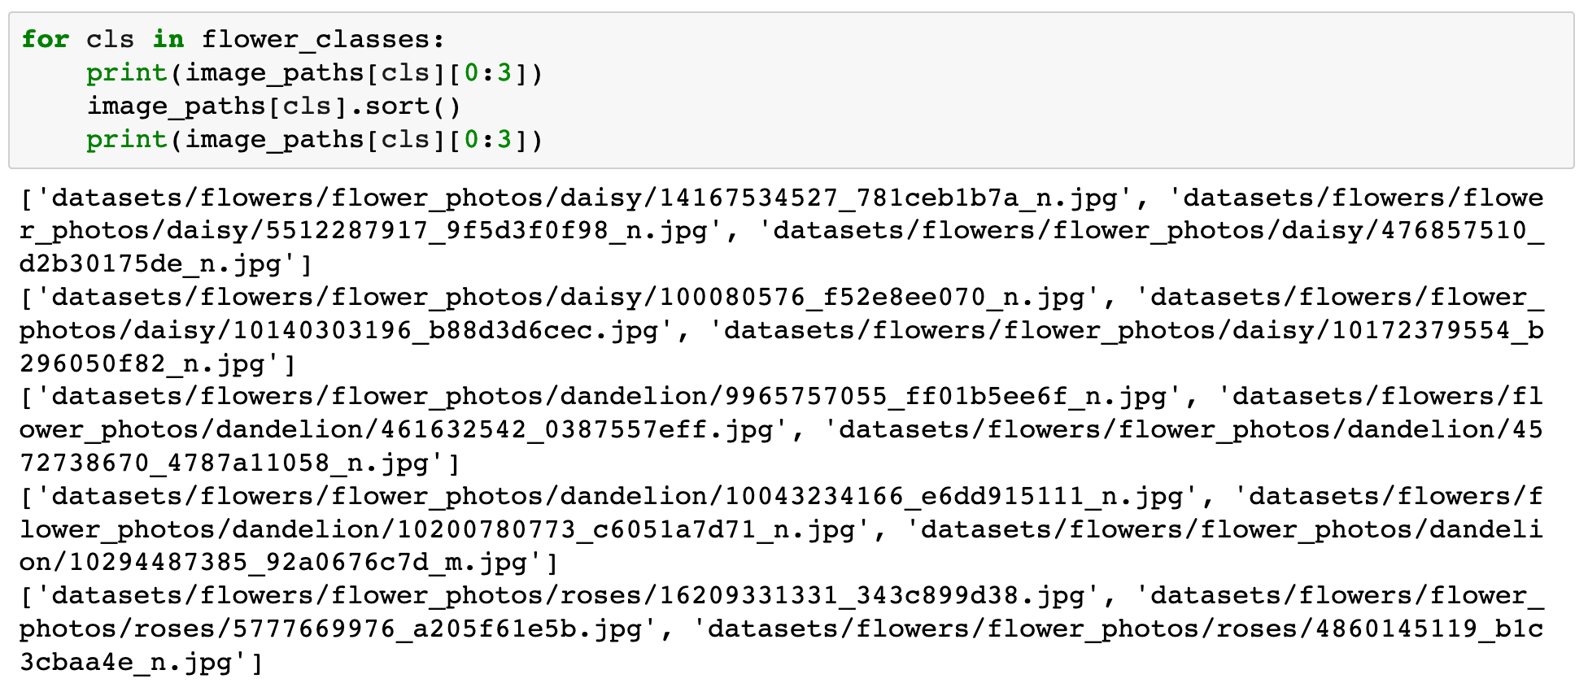

Slide 17
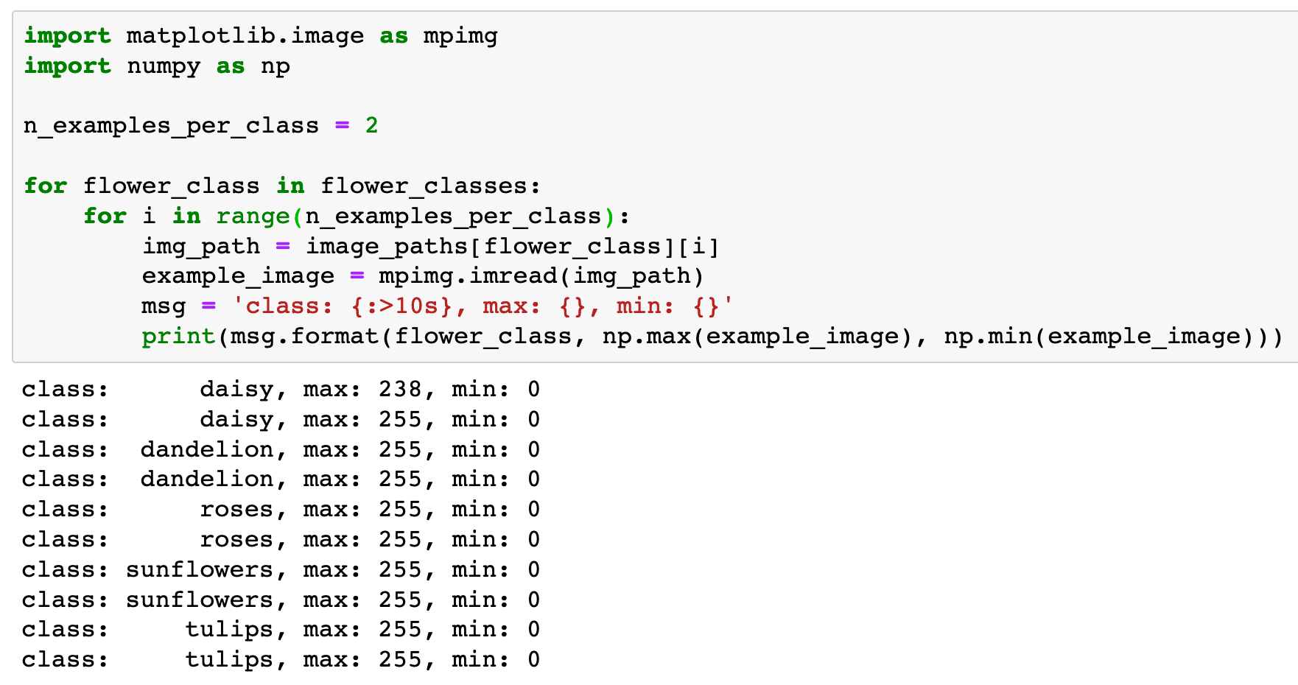

Slide 18
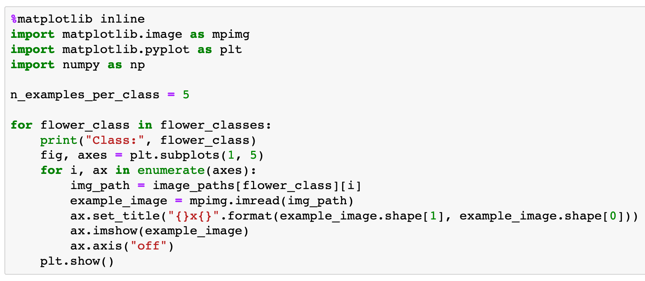

Slide 19


Slide 20
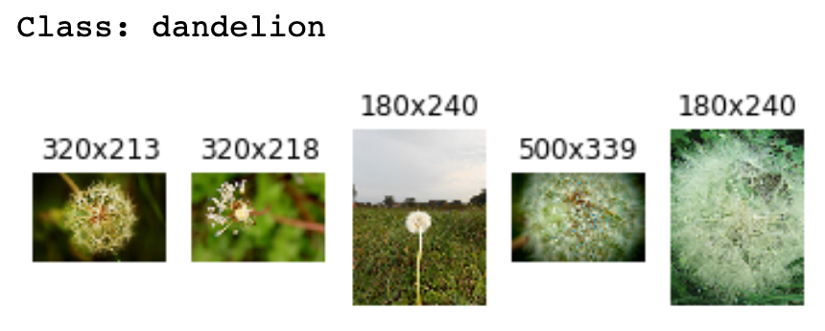

Slide 21
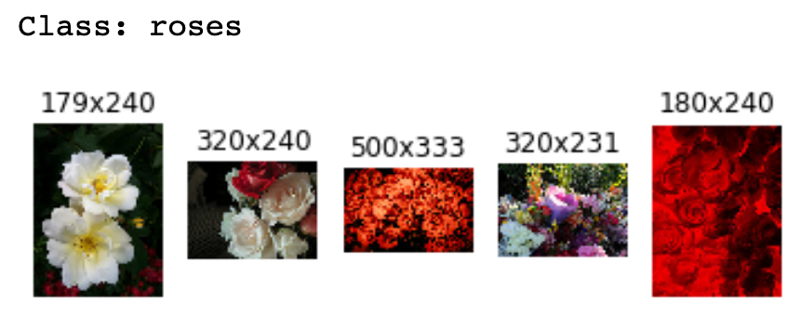

Slide 22
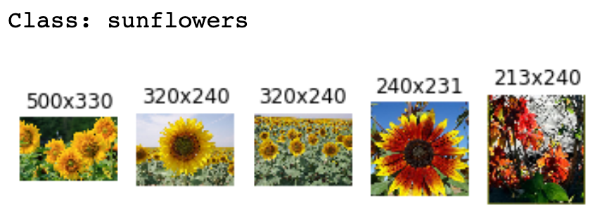

Slide 23


Slide 24
Now
Let’s Play with Code

